Slide 1
DARA Big Data Experiment
Industry: Healthcare
Kaviraj, William, Abdul & Keshav

Slide 2

Research Title
To what extent is the sentiment of the COVID-19 booster shot a measure of protectionism towards global herd immunity?

Slide 3
Introduction
This big data experiment uses descriptive, diagnostic, predictive and prescriptive data analysis techniques to provide a real-world example of how big data, data science and machine learning is applied to uncover patterns, correlations and other insights to investigate the sentiment surrounding the covid-19 booster shot to improve herd immunity based on global Tweeter data (“Tweets”) from the 15th of June 2022 to the 22nd of June 2022.

Slide 4
Hypothesis
H₁: Vaccine hesitancy.
H₂: Protection questions.
H₃: Uneven vaccine access.
H₄: Hybrid Immunity.
Notes:
H₀: Vaccine hesitancy. Some people object to getting a COVID-19 vaccine because of religious objections, fears about the possible risks or skepticism about the benefits. If the proportion of vaccinated people in a community is below the herd immunity threshold, a contagious disease could continue to spread.
H₁: Protection questions. Research suggests that COVID-19 vaccination results in a low risk of infection with the COVID-19 virus for at least six months. However, although COVID-19 vaccines are effective in preventing severe illness from current and possibly future variants, people who are vaccinated and up to date on their vaccines may still get breakthrough infections and spread the virus to others.
H₂: Uneven vaccine access. The distribution of COVID-19vaccines has greatly varied among and within countries. If one community achieves a high COVID-19 vaccination rate and surrounding areas don't, outbreaks can occur if the populations mix.
H₃: Hybrid Immunity. Recent research also suggests that people who got COVID-19 in 2020 and then received mRNA booster vaccines produce very high levels of antibodies that are likely effective against current and, possibly, future variants. Some scientists call this hybrid immunity.

Slide 5
Methodology and Data Management

Slide 6
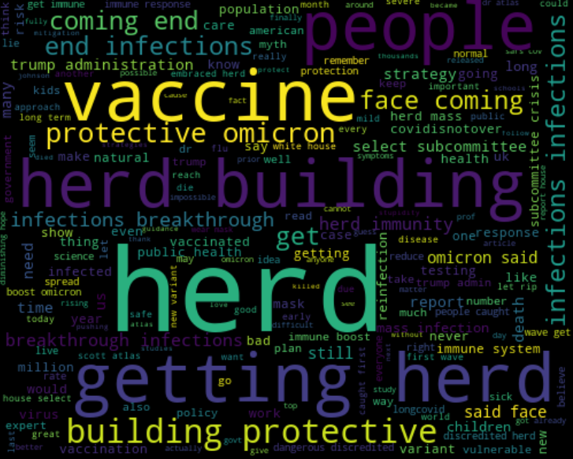
Data
Search words:
"coronavirus OR covid OR pandemic OR covid19 OR lockdown AND herd immunity OR collective immunity OR immunity OR booster"

Slide 7
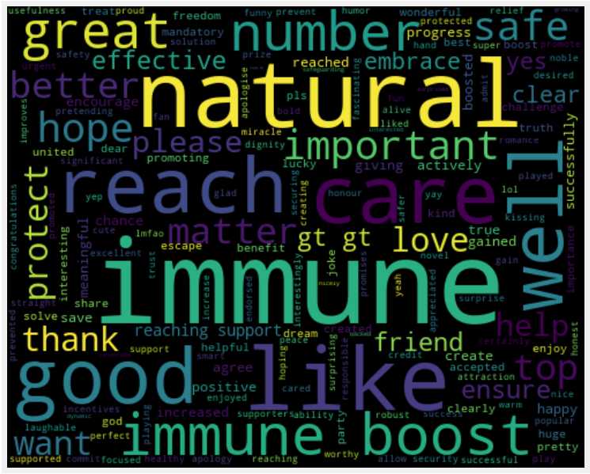
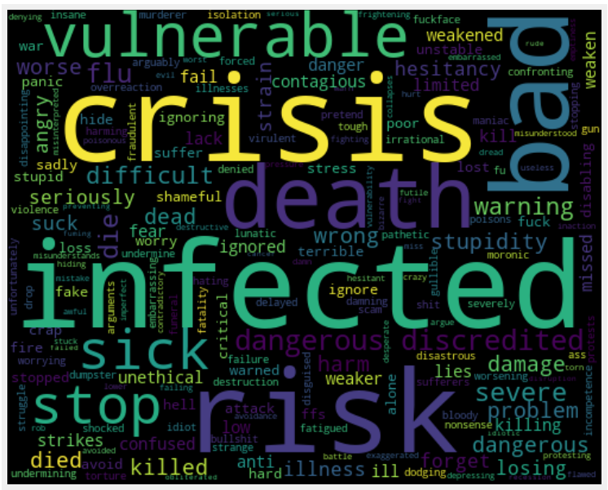
Word Clouds of positive and negative words
Positive
Negative

Slide 8
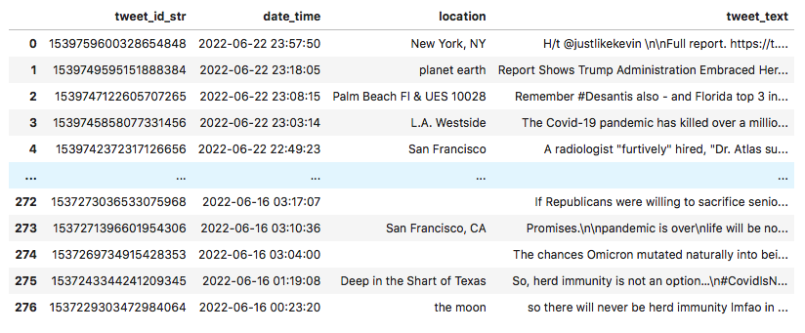
Data
Meta Data / Identifiers:
Location
Language = EN
Label
Date and Time
Tweet ID
Tweet Text
Structured and cleansed data total Rows: 277

Slide 9
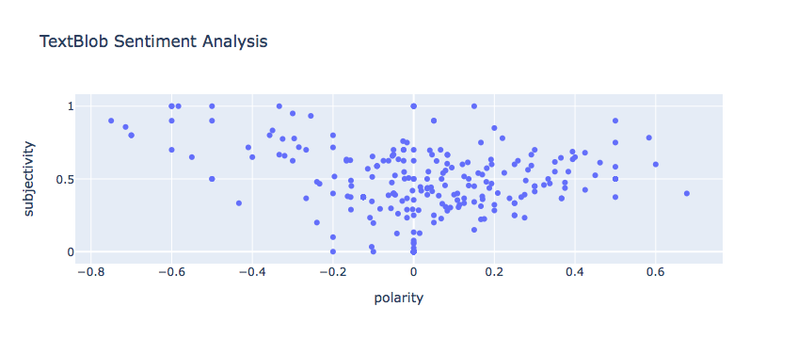
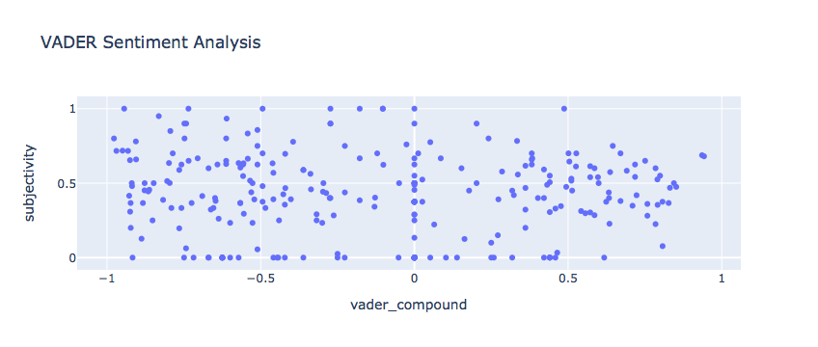
Model
TextBlob
VADER
Accuracy: 47.84%
Accuracy: 50.23%

Slide 10
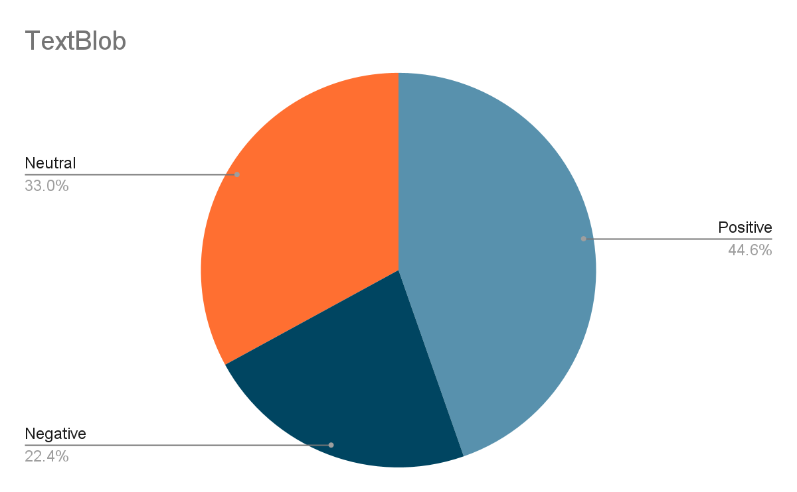
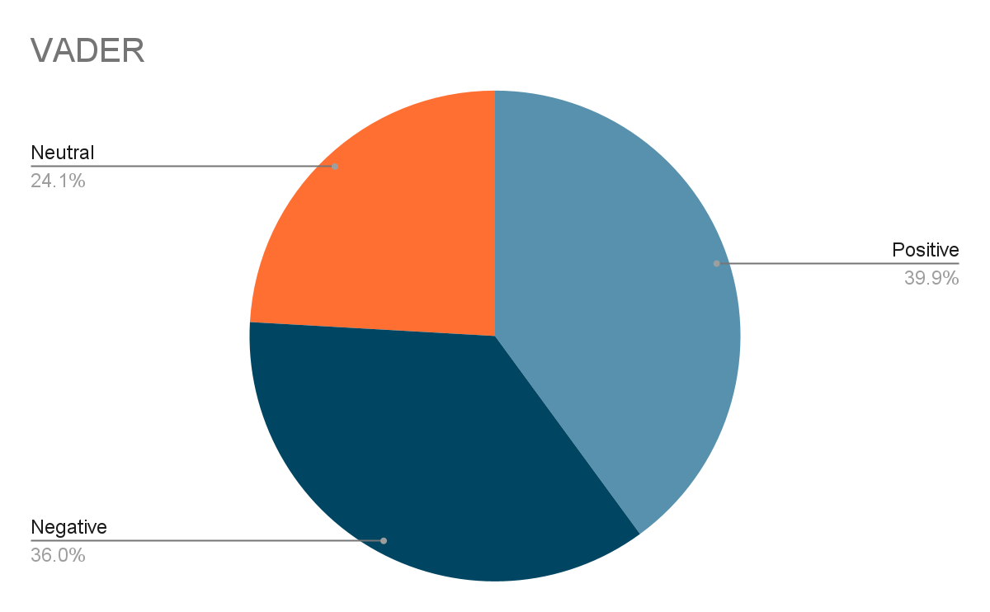
Pie Chart Representation

Slide 11
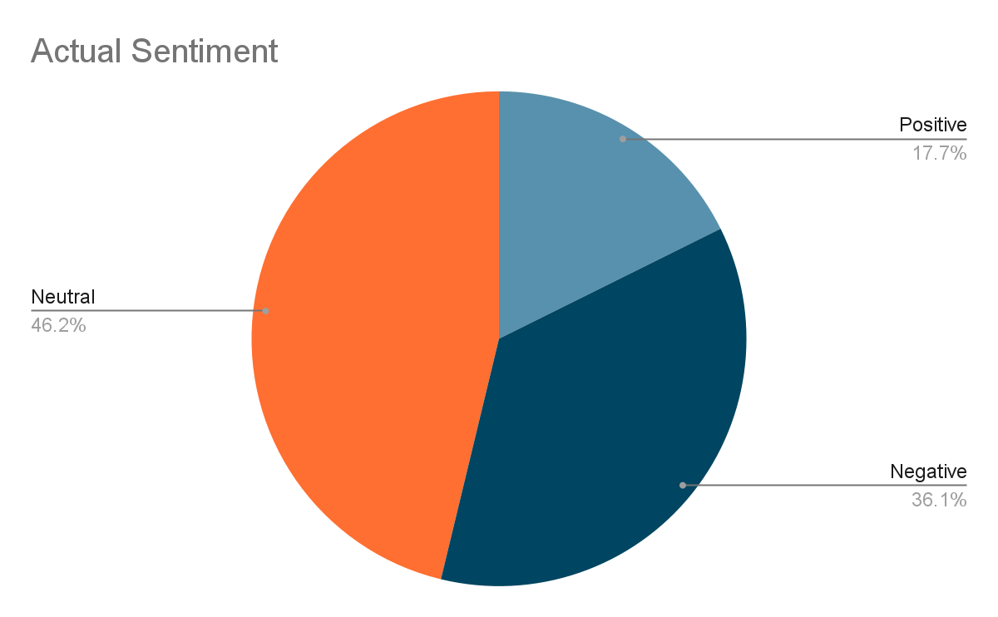
Pie Chart Representation cont.

Slide 12
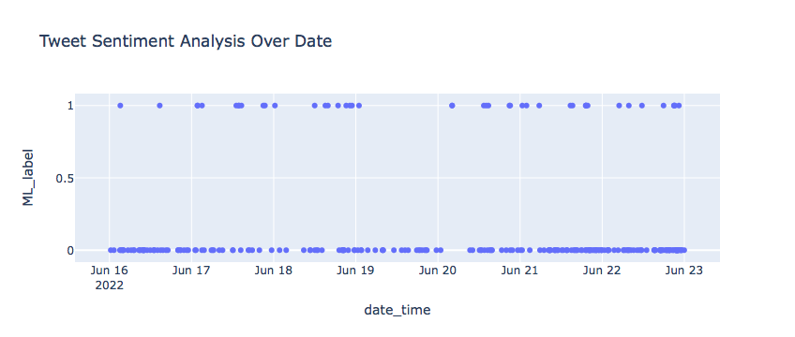
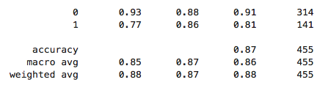
Model
CT-BERT
F1-score = 85.80%
This metric balances the concerns of both precision and recall and is therefore a more reliable measure of performance

Slide 13
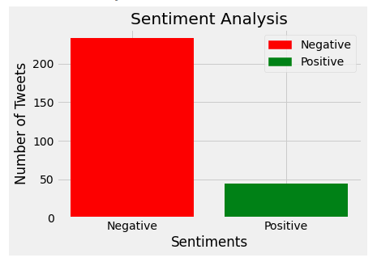
Findings
Negative: 233
Positive: 44

Slide 14
Limitations
The geocode parameter was unable to be used since we could not have enough data from each localised region (i.e Africa, UK)
A major inconvenience was that the standard Twitter API only allows the access of tweets from the last 7 days; we could not extract data from the beginning of the pandemic

Slide 15
Recommendations
More studies: While authors of this study believe it to be one to pave the way for changes in the consciousness of all involved stakeholders. Further studies are to be encouraged if more tangible changes are to be seen in the situation.
mRNA booster shot has just been tested as a hybrid-immunity vaccine. Future studies should be run on datasets covering this new vaccine in order to get more accurate results.

Slide 16
Conclusion

